Slide 1
Instance Segmentation within Unity VirtualHome Environment
Primary Author: Adam Goldstein
Co-Authors: Aishwarya Paruchuri, Krupa Kothadia, Ryan Cummings
Advisor: Dr. Harry Li

Slide 2
Project Overview
Objective: Develop a real-time object detection and segmentation system for Unity VirtualHome to enhance computer vision applications in virtual environments.
Method: Utilize YolactEdge, a state-of-the-art instance segmentation algorithm implemented with PyTorch.
Synthetic Data: Generate and curate synthetic data for training the YolactEdge model using Unity Synthetic Homes and the FiftyOne dataset processing tool.
Integration: Optimize YolactEdge for real-time performance within Unity using TCP/IP socket communication via NetMQ and ZeroMQ messaging libraries.

Slide 3
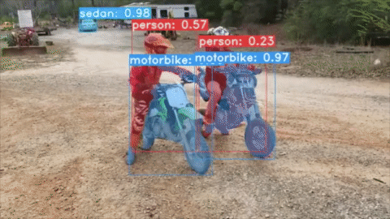
YolactEdge: A State-of-the-Art Instance Segmentation Algorithm
State-of-the-art performance: YolactEdge provides competitive instance segmentation results compared to other algorithms, making it a suitable choice for real-time applications
Real-time processing: YolactEdge is designed for efficient, real-time object detection and segmentation, which is critical for seamless integration into the Unity VirtualHome environment.
TensorRT Optimization: YolactEdge leverages GPU acceleration and is compatible with NVIDIA's TensorRT, a high-performance deep learning inference optimizer, enabling faster processing..
Lightweight architecture: The model's architecture is less complex and resource-intensive than alternative approaches, making it ideal for implementation in a real-time system.

Slide 4
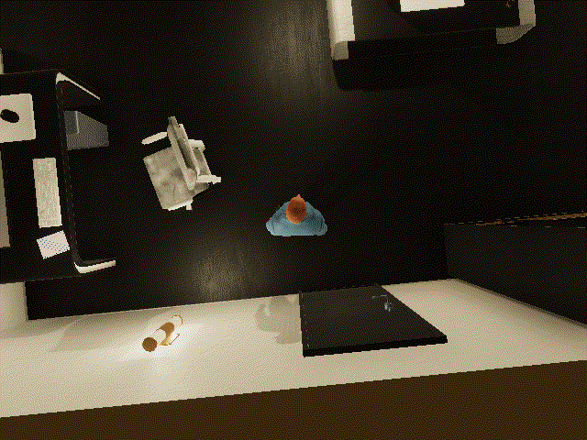
Unity VirtualHome: A Versatile Environment for Computer Vision Applications
Immersive simulation: Unity VirtualHome offers a realistic and customizable 3D environment that replicates various indoor scenarios, ideal for developing and testing computer vision applications.
Rapid prototyping: The platform enables quick development and iteration of virtual scenarios, reducing the time and resources needed for real-world testing.

Slide 5
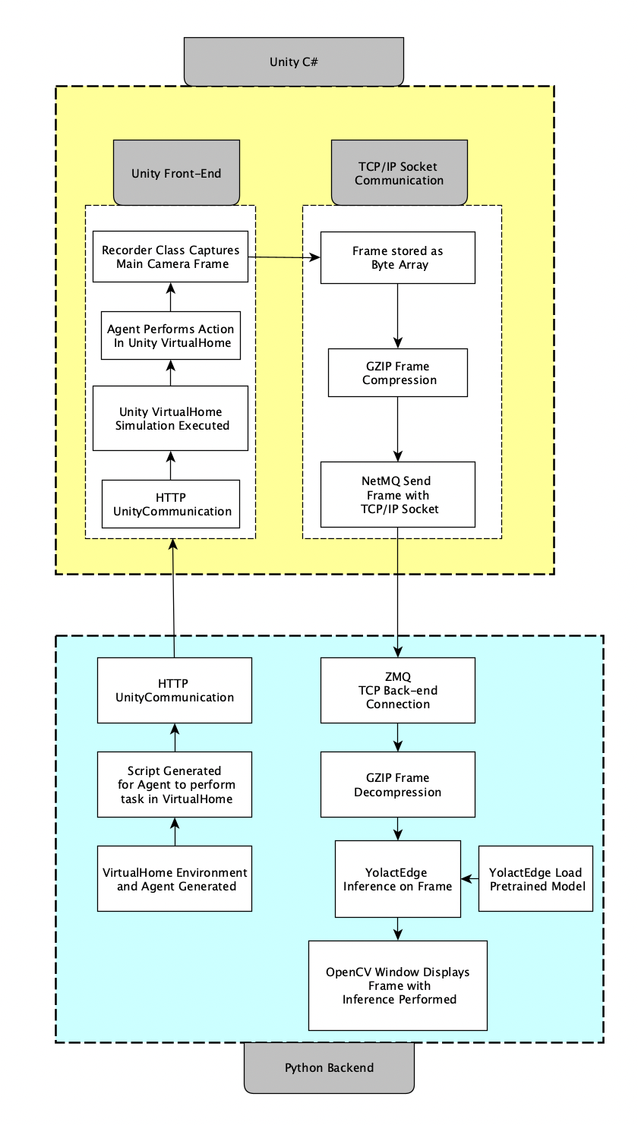
System Architecture
Architecture diagram: shows interface between Python script and Unity VirtualHome for object detection and segmentation with YolactEdge.
Communication: with NetMQ used for TCP/IP Socket Communication to send compressed frames from Unity to Python script.
YolactEdge: model loaded for inference and OpenCV used to display segmented frames, enabling real-time object detection and segmentation in virtual environment.

Slide 6
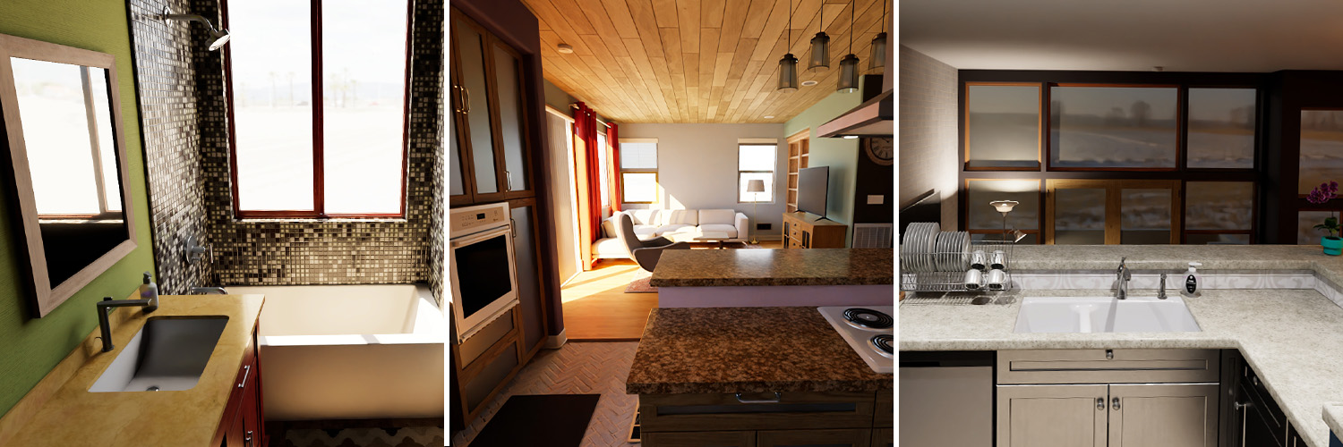
Unity SyntheticHomes
Cost-effective: Training on synthetic data reduces the need for expensive and time-consuming real-world data collection.
Customizable: Synthetic data generation allows for control over the scenarios, objects, and conditions, enabling targeted model training.
Scalability: Large volumes of diverse synthetic data can be generated quickly, providing a rich training set for the model.

Slide 7
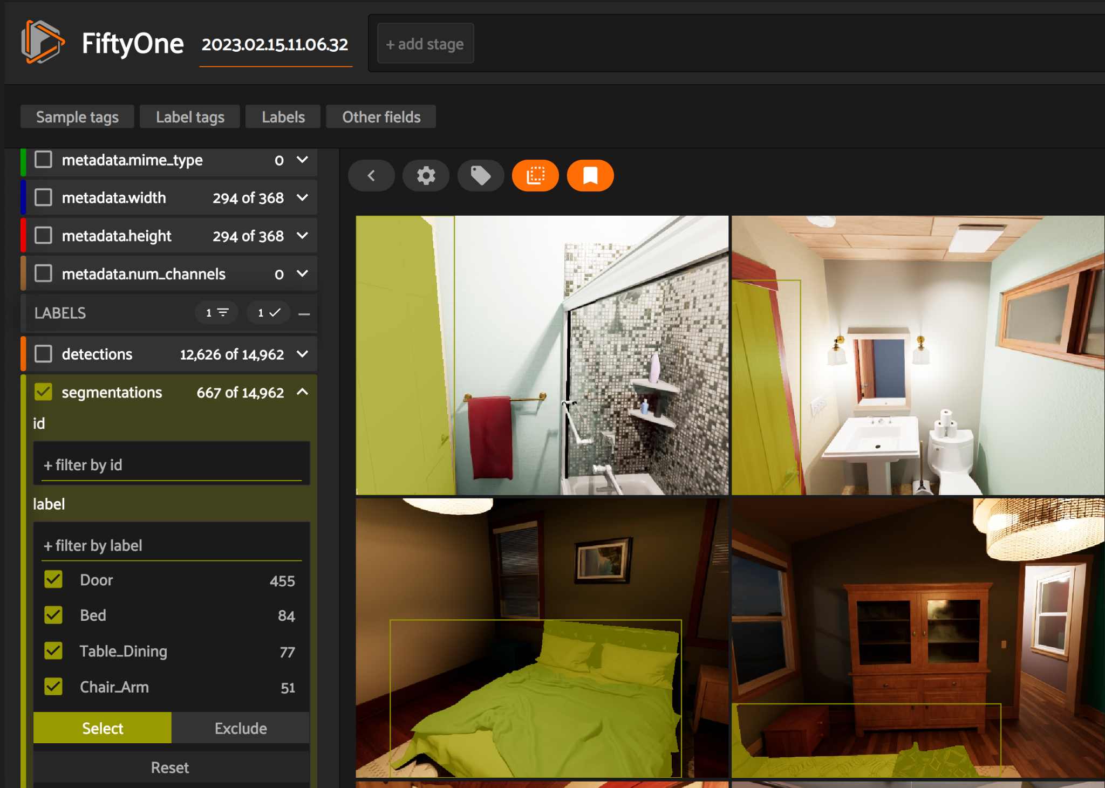
FiftyOne Data Annotation Tools
Efficient annotation: FiftyOne streamlines the process of labeling and annotating synthetic data, ensuring accurate and consistent training input.
Quality control: FiftyOne enables easy visualization and inspection of annotated data, allowing for quality checks and refinements.

Slide 8
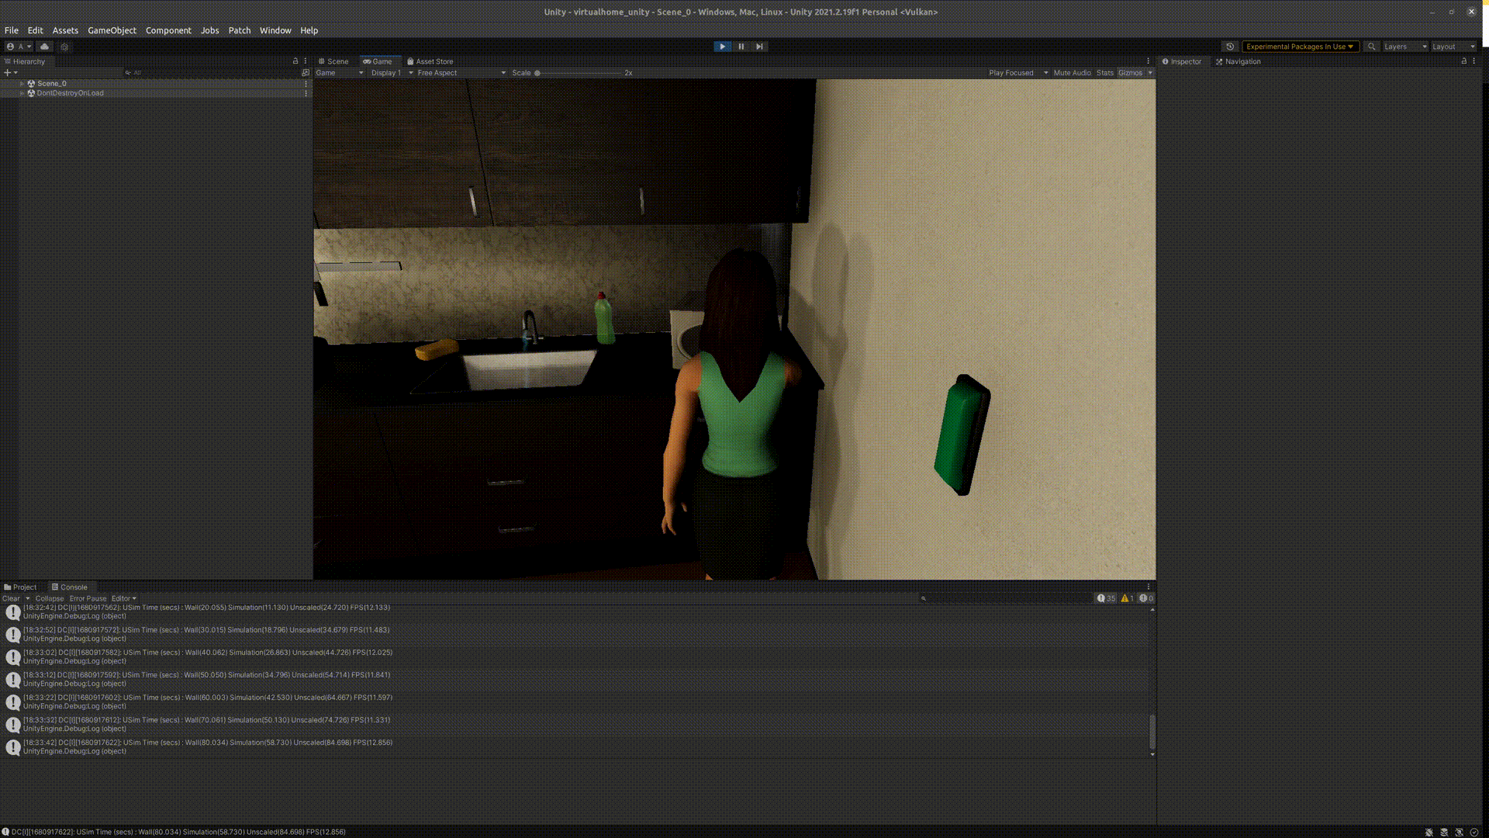
Integration with VirtualHome using TCP/IP Socket Communication
Seamless data transfer: Implementing TCP/IP socket communication with NetMQ and ZeroMQ messaging libraries enables efficient data exchange between the Unity application and the YolactEdge Python program.
Real-time performance: This integration approach supports real-time object detection and segmentation within the Unity VirtualHome environment.

Slide 9
HPC Training and Benefits
Challenges:
High-Performance Computing (HPC) training may require specialized hardware and software, and can be complex to set up.
Various dependency issues w.r.t python packages
Can be complex and time consuming when the data size is large
Benefits:
HPC training accelerates model training
Improves overall model performance
Easy to retrain the model and re-evaluate the test results.

Slide 10
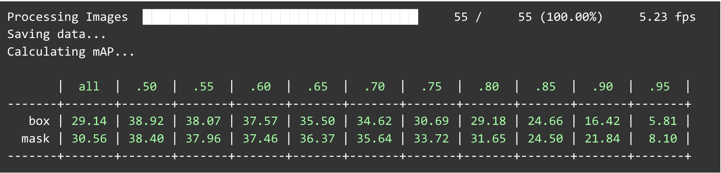
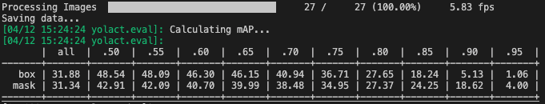
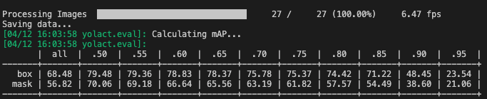
Results - Metrics
Custom Model trained on 1080Ti
Custom Model trained in HPC
Model resumed from YolactEdge (including SyntheticHomes data, trained in HPC)

Slide 11
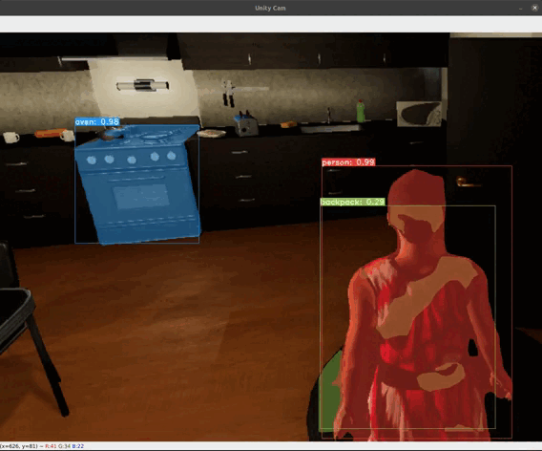
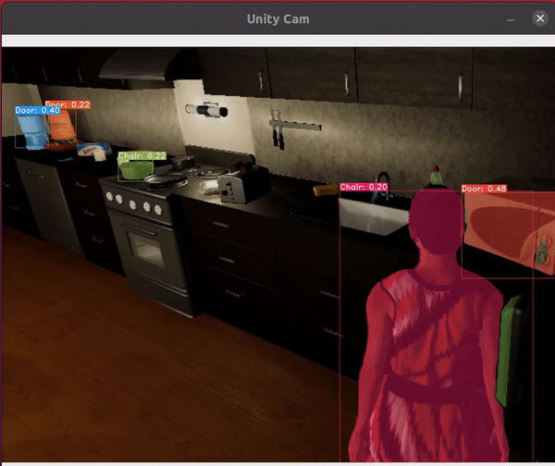
Results - Applied
Pre-trained model trained on the COCO Dataset far outperformed custom trained model
COCO Pre Trained Model
Custom Trained Model

Slide 12
Discussion
Leveraging the COCO pretrained model with concatenated classes was more effective than training the model from scratch, as it allowed us to leverage a model that was trained on a massive dataset with significant computational resources.
However, training the model from scratch with synthetic indoor environment data may be more optimal for our specific application.
This approach requires significant computing resources and data to train and validate the model, which can be a significant challenge.
Running the model on edge computing devices poses challenges due to resource constraints, which can limit the ability to perform real-time inference in some cases.

Slide 13
Conclusion
Project is a novel integration of the YolactEdge instance segmentation algorithm with the Unity VirtualHome environment, enabling real-time object detection and segmentation in a virtual environment.
This integration demonstrates potential techniques to address the challenge of performing accurate inference in real-time
Project has use cases in the fields of robotic vision and indoor augmented reality

Slide 14
Acknowledgements
Acknowledgements: We would like to express our sincere gratitude to Dr. Harry Li for his invaluable guidance, mentorship, and support throughout this project.
His expertise and insights have been instrumental in shaping our approach and achieving our goals. Thank you for your unwavering commitment and dedication.

Slide 15
Contact Information
Project Github: https://github.com/adkap2/Instance-Segmentation-with-Unity-Interactive-Augmented-Reality
Primary Contributor: Adam Goldstein
Email: adam.c.goldstein@sjsu.edu
Group Members:
Ryan Cummings
ryan.cummings@sjsu.edu
Aishwarya Paruchuri
aishwaryaparuchuri@sjsu.edu
Krupa Kothadia
krupaben.kothadia@sjsu.edu

Slide 16
References
1 | R. Wightman and PyTorch Team, "YolactEdge," [Online]. Available: https://github.com/rwightman/yolact_edge. [Accessed: Apr. 11, 2023].
2 | M. R. Hasan et al., "VirtualHome," [Online]. Available: https://virtual-home.org/. [Accessed: Apr. 11, 2023].
3 | Voxel51, "FiftyOne," [Online]. Available: https://voxel51.com/docs/fiftyone/. [Accessed: Apr. 11, 2023].
4 | Unity Technologies, "Unity SyntheticHomes," [Online]. Available: https://unity.com/products/synthetic-data/synthetic-homes. [Accessed: Apr. 11, 2023].

